Slide 1
Android Manifest File
Week 9-10

Slide 2
Manifest File

Slide 3
Contents
What is an Android Manifest File?
Components of an Android Manifest File

Slide 4
Android Manifest File

Slide 5
What is an Android Manifest File?
Every project in Android includes a Manifest XML file, which is the AndroidManifest.xml
It is located in the root directory of its project hierarchy
The manifest file is an important part of our app because it defines the structure and metadata of our application, its components, and its requirements.

Slide 6
What is an Android Manifest File?
The manifest file describes essential information about your app to the Android build tools, the Android operating system, and Google Play.
The manifest file also specifies the application metadata, which includes its icon, version number, themes, etc.

Slide 7
Declared in the manifest file
The components of the app, including all activities, services, broadcast receivers, and content providers.
The permissions that the app needs in order to access protected parts of the system or other apps..
The hardware and software features the app requires, which affects which devices can install the app from Google Play.

Slide 8
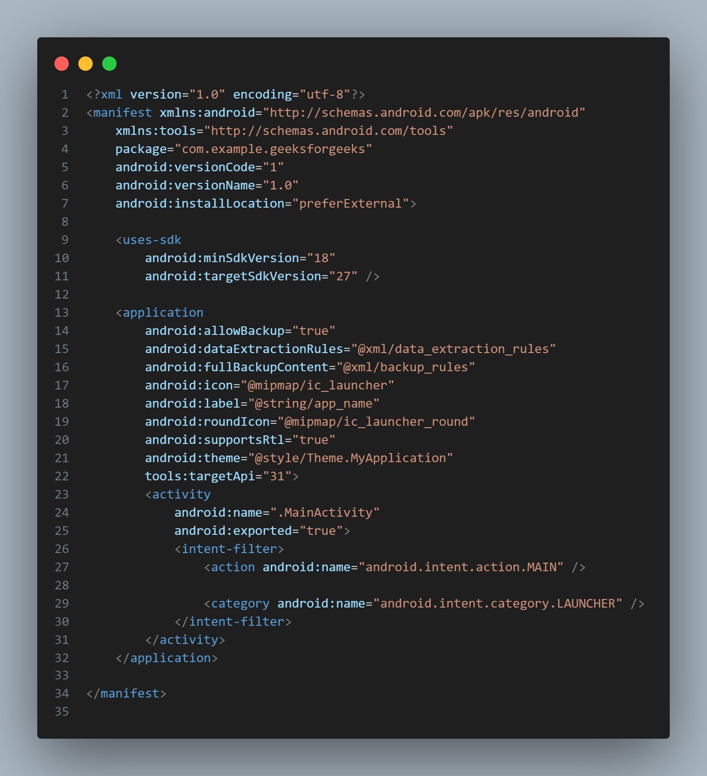
Example of a manifest file

Slide 9
Nodes in the manifest file
A manifest file includes the nodes that define the application components, security settings, test classes, and requirements that make up the application.
Some of the manifest sub-node tags that are mainly used are:

Slide 10
Nodes in the manifest file
manifest | <manifest> … </manifest>
uses-sdk | <uses-sdk/>
uses-permission | <uses-permission/>
application | <application> … </application>
uses-library | <uses-library/>
activity | <activity> </activity>
intent-filter | <intent-filter> … </intent-filter>

Slide 11
Nodes in the manifest file
action | <action/>
category | <category/>
uses-configuration | <uses-configuration/>
uses-feature | <uses-features/>
permission | <permission> … </permission>

Slide 12
<manifest>
The main component of the AndroidManifest.xml file is known as manifest.
It must contain an <application> element with the xmlns:android and package attribute specified.

Slide 13
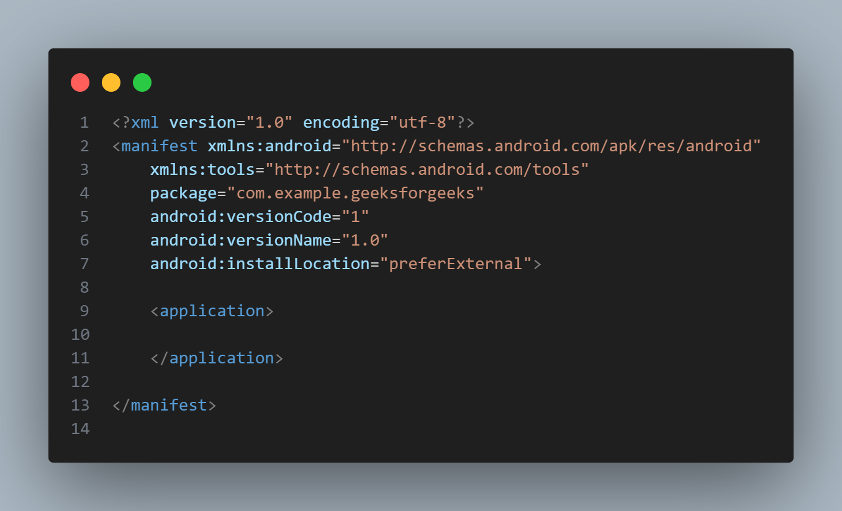
<manifest>

Slide 14
<uses-sdk/>
It is used to define a minimum and maximum SDK version that must be available on a device so that our application functions properly.
And also the target SDK for which it has been designed.

Slide 15
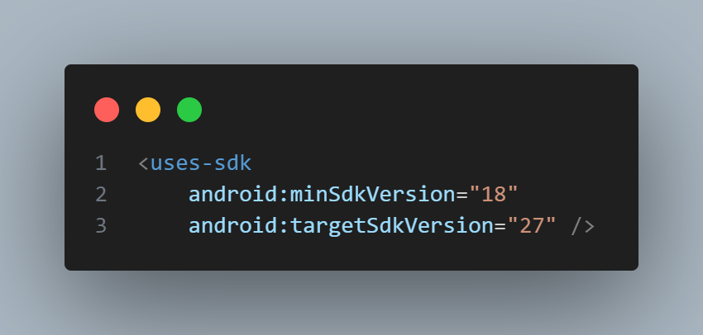
<uses-sdk/>

Slide 16
<uses-permission/>
It outlines a system permission that must be granted by the user for the app to function properly and is contained within the <manifest> element.

Slide 17
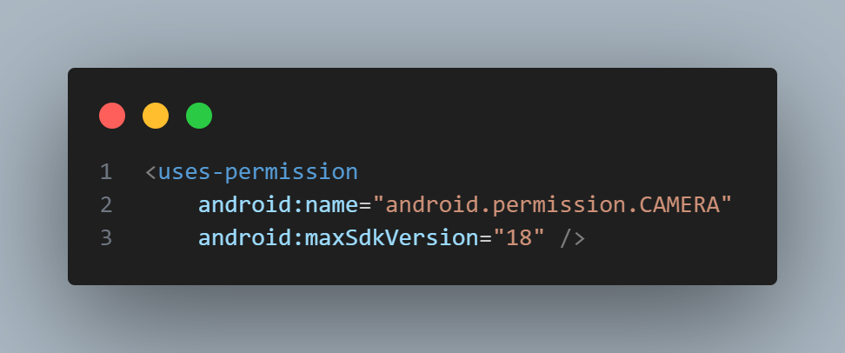
<uses-permission/>

Slide 18
<application>
A manifest can contain only one application node.
It uses attributes to specify the metadata for your application (including its title, icon, and theme). During development,

Slide 19
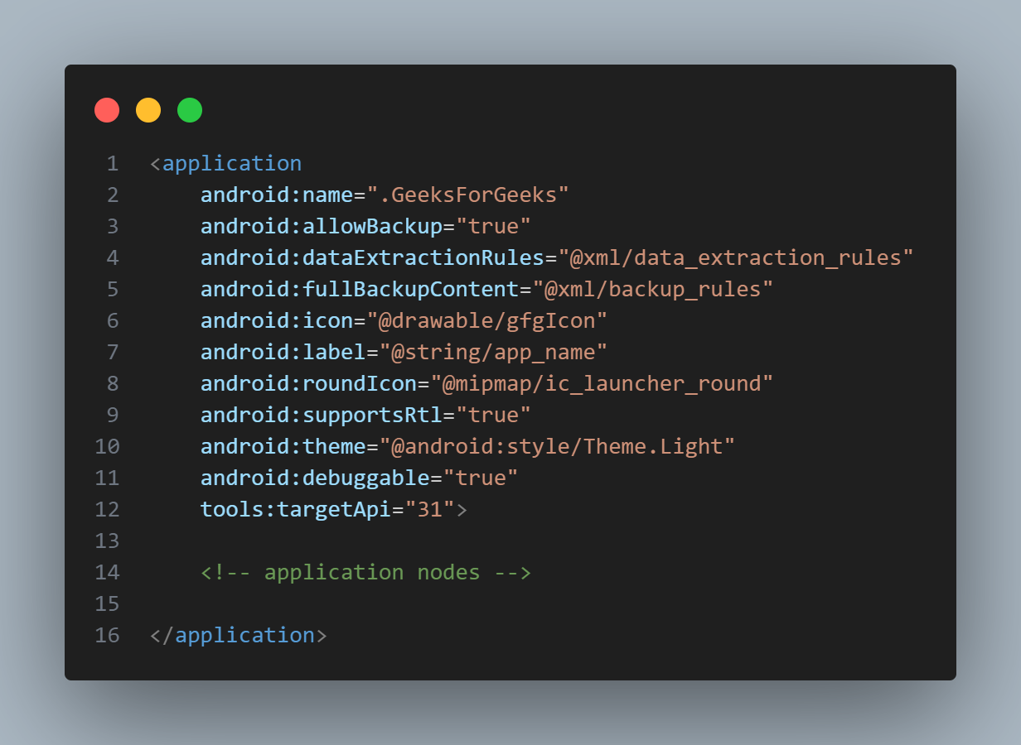
<application>

Slide 20
<uses-library/>
It defines a shared library against which the application must be linked.
This element instructs the system to add the library’s code to the package’s class loader.
It is contained within the <application> element.

Slide 21
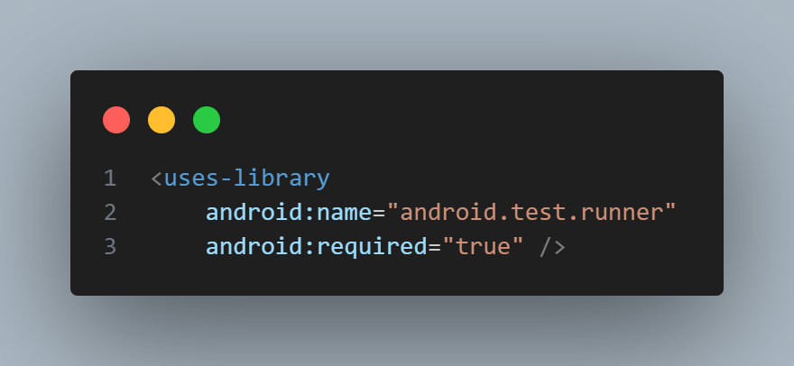
<uses-library/>

Slide 22
<activity>
The Activity sub-element of an application refers to an activity that needs to be specified in the AndroidManifest.xml file.
Any activity that is not declared there won’t run and won’t be visible to the system.
It is contained within the <application> element.

Slide 23
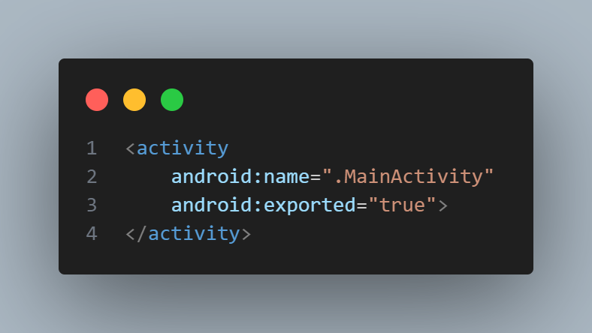
<activity>

Slide 24
<intent-filter>
It is the sub-element of activity that specifies the type of intent to which the activity, service, or broadcast receiver can send a response.
It allows the component to receive intents of a certain type while filtering out those that are not useful for the component.

Slide 25
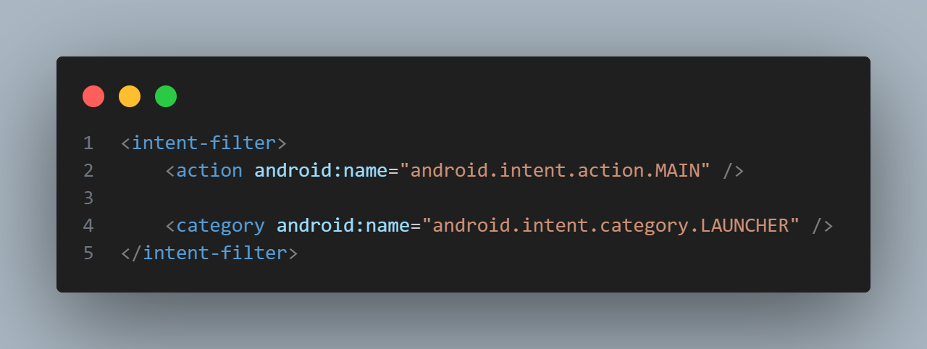
<intent-filter>

Slide 26
<action>
It adds an action for the intent-filter.
It is contained within the <intent-filter> element.

Slide 27
<action>

Slide 28
<category>
It adds a category name to an intent-filter. It is contained within the <intent-filter> element.

Slide 29
<category>

Slide 30
<uses-features>
The uses-configuration components are used to specify the combination of input mechanisms that are supported by our application.
It is useful for games that require particular input controls.

Slide 31
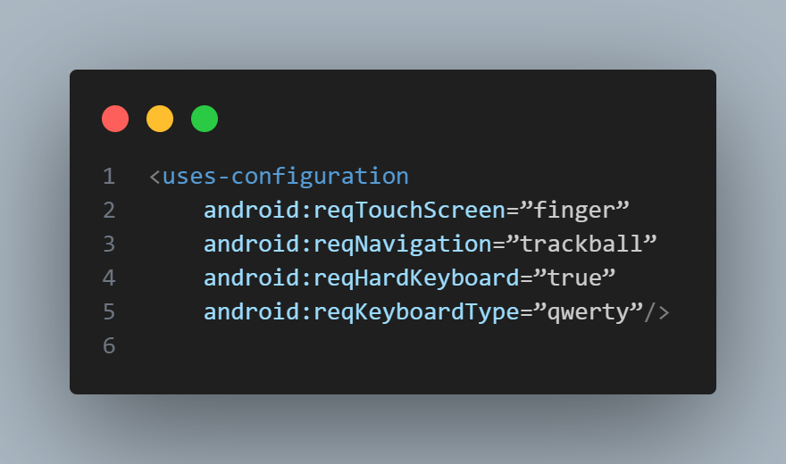
<uses-configuration>

Slide 32
<uses-features>
It is used to specify which hardware features your application requires.
This will prevent our application from being installed on a device that does not include a required piece of hardware such as NFC hardware, as follows:

Slide 33
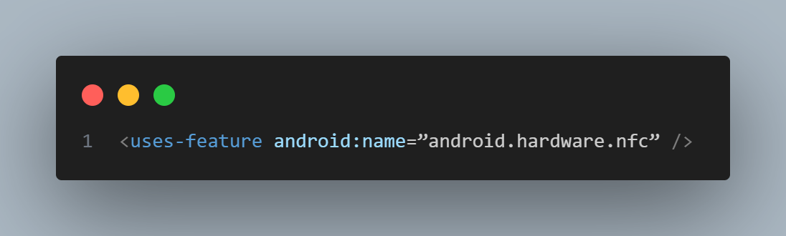
<uses-configuration>

Slide 34
<permission>
It is used to create permissions to restrict access to shared application components.
We can also use the existing platform permissions for this purpose or define your own permissions in the manifest.

Slide 35
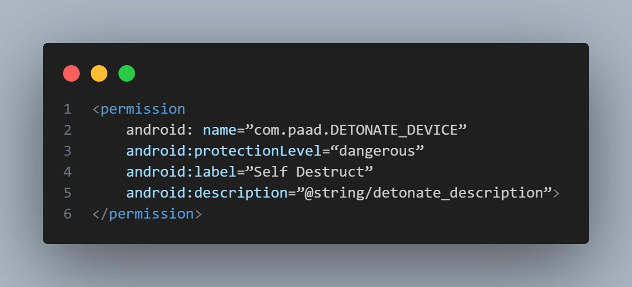
<permission>

Slide 36
END

